Slide 1
Creative Arts – Drama
Year 9 and 10

Slide 2
What do you do?
Engage with the elements of production, participating in rehearsing and performing a full-length production presented to the school community.
Develop a monologue for performance.
Participate in creating original Children’s Theatre performed to students in K-6.
Develop original drama and theatre in small groups.

Slide 3
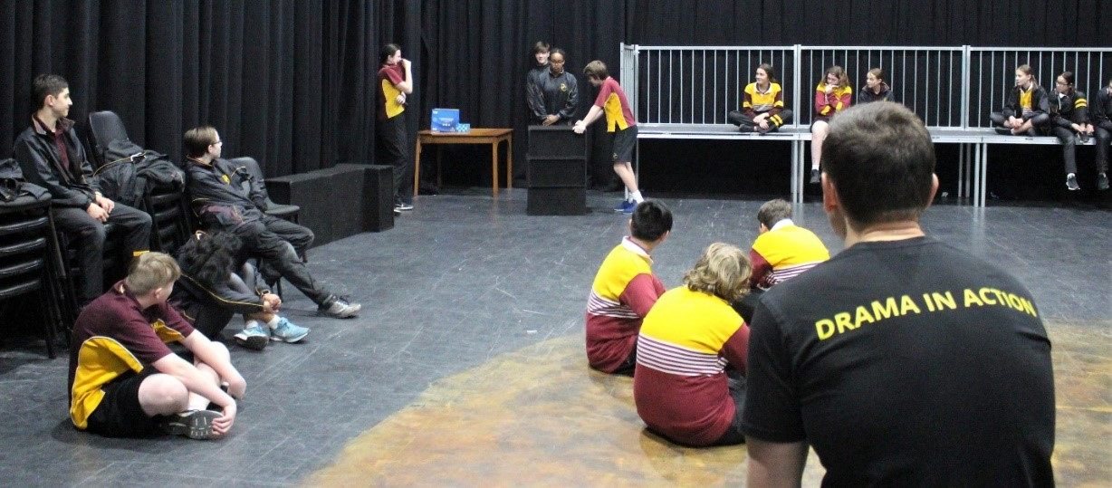
What do you do?
Assessment is practical. You will present polished performances of scripted and self-devised work backed up with written work and research in your Logbook. You will also learn about how productions are made and gain experience and knowledge in lighting, sound, poster, set and costume design.
The course is designed to build foundations that can prepare you for Drama in Years 11 and 12 and beyond.

Slide 4
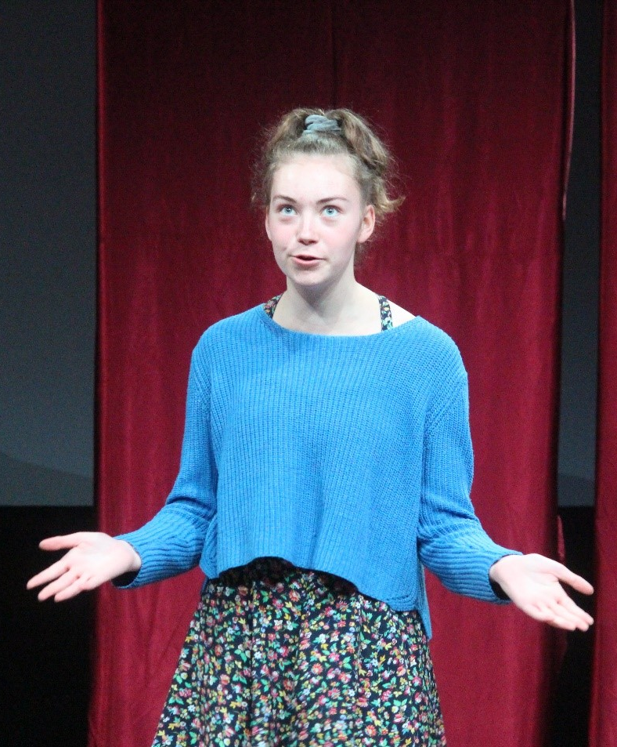
What you need?
Energy.
Enthusiasm.
A willingness to participate and learn about yourself, the world around you.

Slide 5
Find out more…
Please feel free to contact Mr Mike O’Brien, Head of Creative Arts, at mobrien@dominic.tas.edu.au

